Slide 1

Capstone Project Group 5
Prediction On Brain Tumor, Skin cancer and Lung Cancer.
Guide – Sodiq Shofoluwe

Slide 2
Group members
1. Parth Patel
2. Dhruval Patel
3. Neha Babu
4. Kawalbeer Kaur
5. Neha Rani

Slide 3
Introduction
Cancer is a leading cause of death worldwide and affects millions of people. According to the World Health Organization (WHO), cancer is responsible for an estimated 9.6 million deaths in 2021.
The most common types of cancer worldwide are Brain,skin,lung, prostate, colorectal, stomach, and liver cancer. These types of cancer are responsible for almost half of all cancer cases and deaths globally.
Prevention, early detection, and treatment are crucial in reducing the impact of cancer on individuals and communities. WHO recommends a comprehensive approach that includes promoting healthy lifestyles, increasing access to cancer screening and early detection, and improving access to cancer treatment.
In this project we are discussing about the following types of cancer.
Brain Tumour
Skin cancer
Lung Cancer
Reference- https://www.cancer.gov/about-cancer/understanding/what-is-cancer#:~:text=Cancer%20is%20a%20disease%20caused,are%20also%20called%20genetic%20changes.

Slide 4
Brain Tumor
A brain tumor is a mass or growth of abnormal cells in the brain, which can interfere with normal brain function and potentially be life-threatening. Symptoms may include headaches, seizures, and changes in mental or physical functioning.
There are 3 types of tumor we found in our dataset
Glioma tumor: This is a type of brain tumor that originates from the glial cells of the brain. Glial cells are cells that support and protect neurons in the brain. Gliomas are typically classified by their grade, which is a measure of how fast the tumor is growing and how abnormal the cells look under a microscope.
Meningioma tumor: This is a type of brain tumor that develops from the meninges, which are the protective membranes that surround the brain and spinal cord. Meningiomas are typically slow-growing and may not cause symptoms, but they can become dangerous if they grow large enough to put pressure on the brain.
Pituitary tumor: This is a type of brain tumor that develops in the pituitary gland, which is a small gland located at the base of the brain. The pituitary gland produces hormones that control various bodily functions. Pituitary tumors can cause hormonal imbalances, which can lead to a variety of symptoms.

Slide 5
About Brain Tumour Dataset
This dataset contains 7022 images of human brain MRI images which are classified into 4 classes: glioma - meningioma - no tumor and pituitary.
We have a 1721 images for a glioma tumour, 1645 for a meningioma,2000 images for a no tumour,1757 images for a pituitary tumour.

Slide 6
Lung Cancer
Lung cancer is a type of cancer that starts in the lungs. It is one of the most common types of cancer worldwide and is a leading cause of cancer-related deaths.
The main cause of lung cancer is smoking, which is responsible for around 80-90% of cases. Other risk factors include exposure to radon, air pollution, and certain chemicals.
Symptoms of lung cancer can include a persistent cough, chest pain, shortness of breath, and coughing up blood. However, some people may not experience any symptoms until the cancer has advanced.
Early detection through screening can improve the chances of successful treatment and long-term survival.
We have 3 classes in lung cancer Bengin cases, Malignant cases, & Normal cases.

Slide 7
About Lung Cancer Dataset
The IQ-OTHNCCD lung cancer dataset is a collection of chest X-ray images of patients with and without lung cancer. The images were collected from multiple sources and institutions and were annotated to indicate the presence or absence of lung cancer. The dataset contains a total of 2451 chest X-ray images.

Slide 8
Skin cancer
Skin cancer is a condition in which abnormal growth of skin cells occurs, often as a result of exposure to ultraviolet radiation from the sun or tanning beds. It can manifest as a variety of different types of skin lesions, and early detection is important for successful treatment outcomes.
There are several types of skin cancer
Actinic keratoses and intraepithelial carcinoma / Bowen's disease (akiec), basal cell carcinoma (bcc), benign keratosis-like lesions
(solar lentigines / seborrheic keratoses and lichen-planus like keratoses, bkl), dermatofibroma (df), melanoma (mel), melanocytic nevi (nv) and vascular lesions
(angiomas, angiokeratomas, pyogenic granulomas and hemorrhage, vasc).

Slide 9
About skin cancer dataset
The HAM10000 dataset is a collection of images of skin lesions, including both benign and malignant tumors. It was created by collecting biopsy-confirmed images of skin lesions and was made publicly available for research purposes. The dataset contains 10,015 images and each image is annotated with a diagnosis of one of seven different skin conditions.

Slide 10
Problem statement
The objective of this project is to develop a machine learning model for the diagnosis of three types of cancers brain tumor, skin cancer, and lung cancer.
The model will be trained on a large dataset of medical images and clinical data to accurately identify these types of cancer, thus providing a more efficient and accurate method of diagnosis.
This project also aims to develop a website that can predict if a person has brain tumor, skin cancer or lung cancer by uploading the images of respective cancers.
This innovative approach will improve the speed, accuracy, and accessibility of cancer diagnosis, enabling patients to receive timely and effective treatments. The project will be a significant contribution to the field of medical technology and has the potential to save countless lives.

Slide 11
Problem solution
Early Detection for a cancer is useful and it can save a life of a person.
Accurate and timely diagnoses
Through this Healthcare Professional & Patients can have an accurate result about their cancer.
It solves doubts of some individuals.

Slide 12
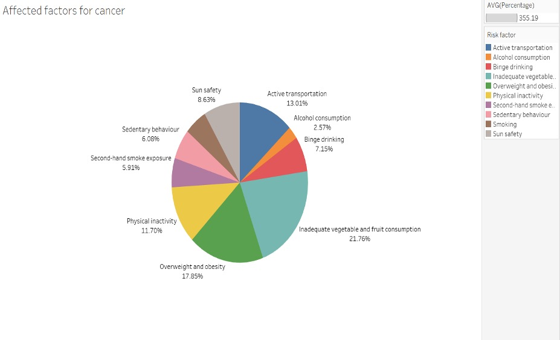
Main factors affecting cancer

Slide 13
Our Approach
Our approach uses convolutional neural network (CNN) to classify different cancer into its categories.
Split the dataset: The dataset is split into training, validation, and test sets. Then shuffles the data if specified, and then takes the specified proportions of the data for each set.
Preprocess the images: The images are preprocessed in the model using a rescaling layer to normalize the pixel values to the range [0, 1]. Data augmentation is also an option in the code, which applies random flips and rotations to the images.
Model Architecture: The model consists of several convolutional layers followed by max pooling layers to reduce the spatial dimensions of the output feature maps. The final output is passed through a fully connected layers with the final layer having a softmax activation function to output the predicted class probabilities.
Train the model: The model is trained using the fit() method, with the training set and validation set as inputs.
Predict new images: The model can be used to predict the class probabilities of new images. Using the preprocessing.image module from Keras helps to predict the loaded image into the specified classification.

Slide 14
For brain and lung cancers we possessed labelled data. However, in the case of skin cancer, labeled data is not readily available. Therefore, we make use of metadata which contains CSV file of image ID and the corresponding cancer type label.
Then we integrate that csv to the images and then made a model to predict the cancer.

Slide 15
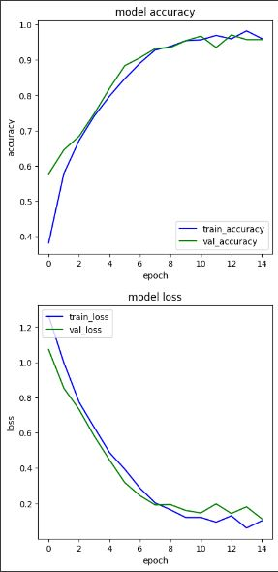
Accuracy and loss for a brain tumour
Model CNN.
BATCH_SIZE = 62
IMAGE_SIZE = 256
EPOCHS=15
Accuracy is 96%.
Loss is 18.42%
Validation accuracy is 95.81%
Validation loss is 18.11%

Slide 16
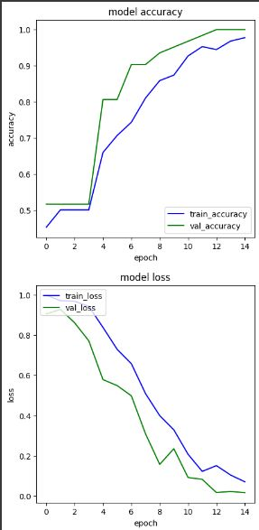
Accuracy and loss for a lung cancer
Model CNN.
BATCH_SIZE = 62
IMAGE_SIZE = 256
EPOCHS=15
Accuracy is 96.24%
Loss is 13.54%
Validation accuracy is 95.81%
Validation loss is 18.11%

Slide 17
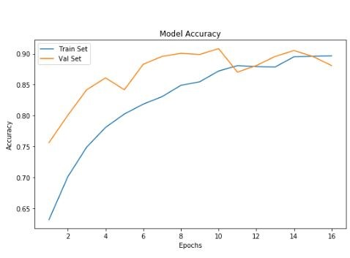
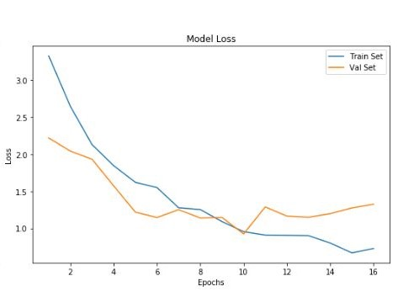
Accuracy and loss for a Skin cancer
Model Resnet 50.
BATCH_SIZE = 16
IMAGE_SIZE = 256
EPOCHS=50
Accuracy is 87.2%
Loss is 10.41%
Validation accuracy is 92.12 %
Validation loss is 15.36%

Slide 18
Website Architecture
Used Flask framework to handle HTTP requests and responses.
Add an HTML/CSS template to provide the user interface for the web application.
A Python code is written to handle user input from the HTML form and use it to call the cancer detection models.
The image detection model will take an image as an input and return a prediction

Slide 19
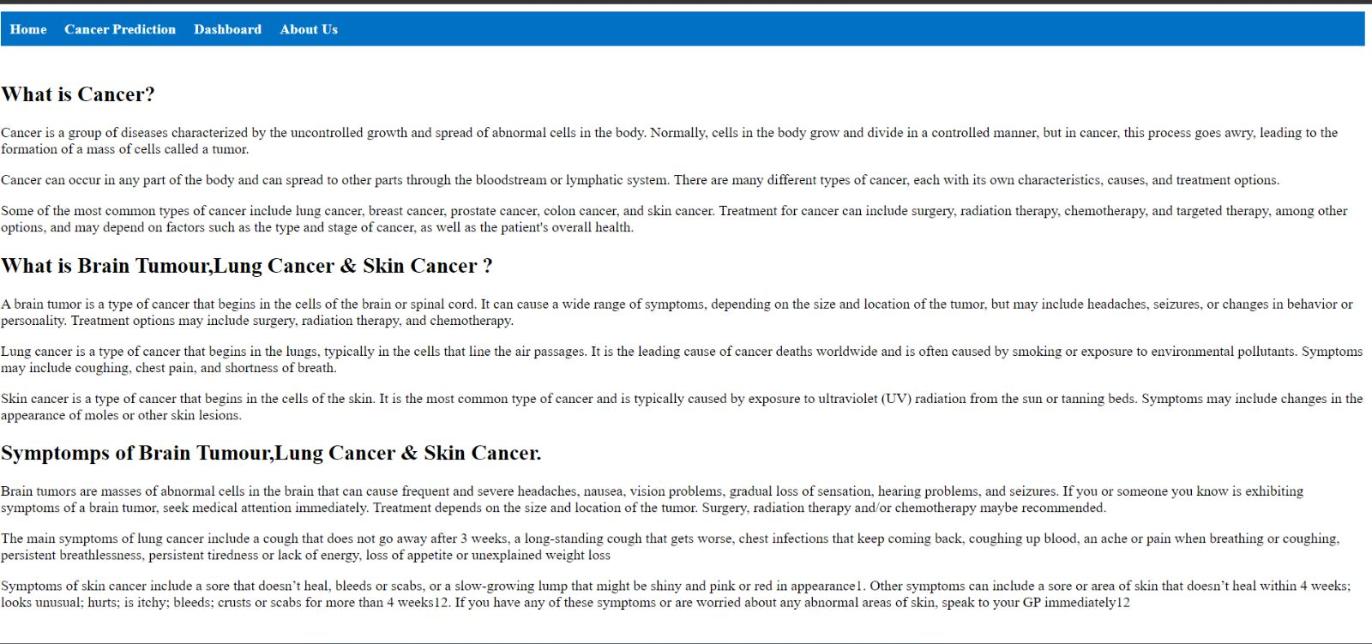
Website Layout

Slide 20
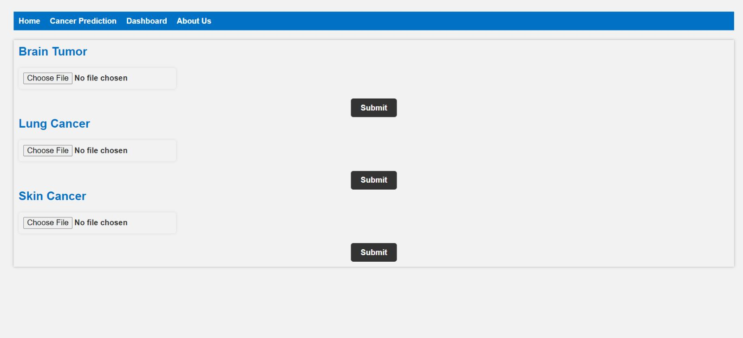

Slide 21
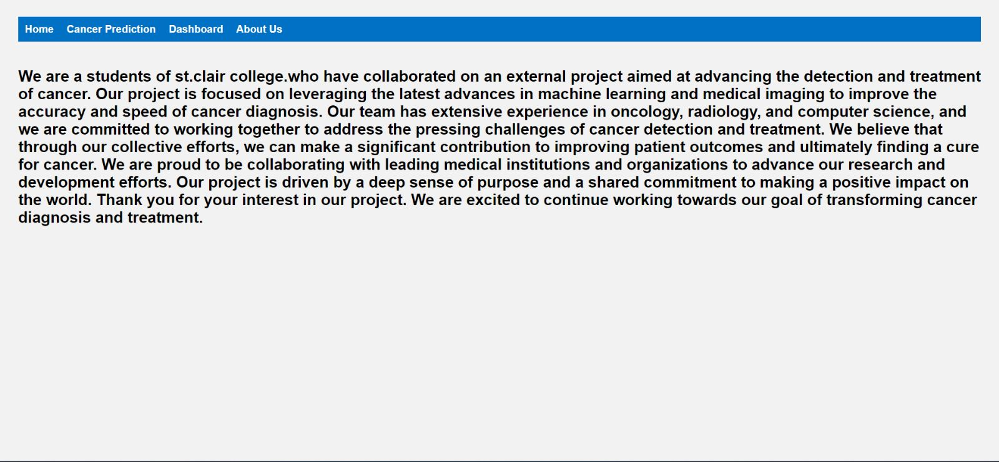

Slide 22
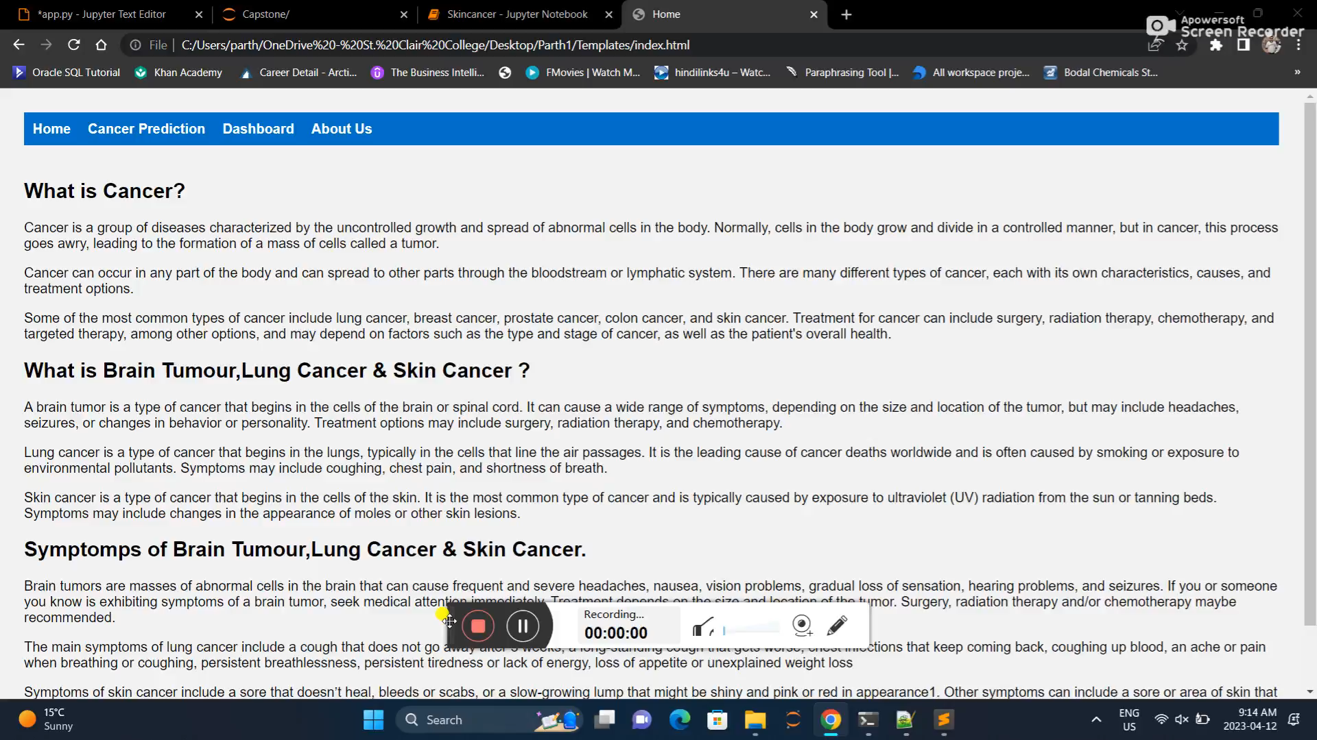

Slide 23
References
https://dataverse.harvard.edu/dataverse/harvard
https://towardsdatascience.com/convolutional-neural-networks-explained-9cc5188c4939#:~:text=A%20Convolutional%20Neural%20Network%2C%20also,binary%20representation%20of%20visual%20data.
https://www.tensorflow.org/tutorials/images/cnn
https://stackoverflow.com/questions/59402131/how-can-i-make-a-single-prediction-on-a-model-using-sklearn-in-python
https://towardsai.net/p/l/how-to-predict-multiple-variables-with-one-model-and-why
https://medium.com/@shivamkhandelwal555/a-proper-way-of-declaring-models-in-flask-9ce0bb0e42c1

Slide 24

Thank You

